Slide 1



February 28, 2026
Governmental
and
zoning
Session Three:
1:10 p.m. to 2:00 p.m.
Presented by
Valerie Watson, Fair Housing Manager
Stark County Fair Housing Department

Slide 2


AGENDA
Fair Housing Law Overview
What Does Fair Housing Has to do With Zoning
Disability Rights
Reasonable Accommodation
Examples of Illegal Zoning Practices
Discrimination Can Be Costly

Slide 3


Fair Housing Law
of
Civil Rights Act of 1866
Prohibits discrimination on the basis of race and color. All citizens of the United States shall have the same right as is enjoyed by white citizens to inherit, purchase, lease, sell, hold, and convey real and personal property.

Slide 4

Fair Housing Law
of
Title VI of the Civil Rights Act of 1964
Prohibits discrimination on the basis of race, color, or national origin in programs and activities receiving federal financial assistance.

Slide 5


Slide 6
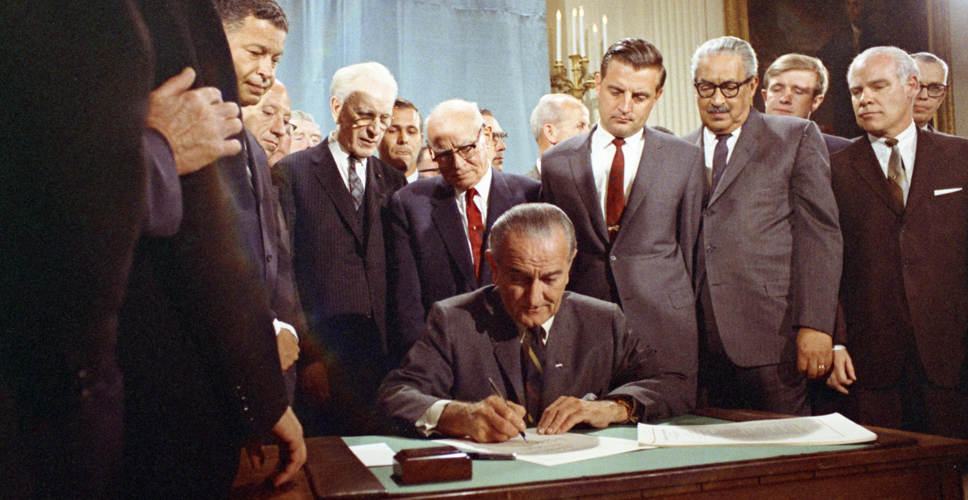
April 11, 1968 President Johnson Signs the Civil Rights Act of 1968

Slide 7
Civil Rights Act of 1968
President Lyndon B. Johnson signed the Fair Housing Act into law seven days after Dr. Martin Luther King's assassination
prohibits discrimination concerning the sale, rental, and financing of housing
follow-up to the Civil Rights Act of 1964based on race, color, religion, and national origin

Slide 8

April proclaimed as FAIR HOUSING MONTH
Commemorating the
Fair Housing Act
1968 - 2025

Slide 9


RACE (African American, White, Asian)
COLOR (shade of skin color)
SEX (gender and persons who experience sexual harassment)
RELIGION (Christianity, Islam, Buddhism)
NATIONAL ORIGIN (Mexican, American Indian, Pacific Islander, Alaskan Native, Russian, Chinese, Other)
FAMILIAL STATUS (Families with children under 18 years old)
DISABILITY (A person with a physical or mental impairment)
PROTECTED CLASSES

Slide 10

Fair Housing Law
of
Section 504 of the Rehabilitation Act of 1973
Prohibits discrimination based on disability in any program or activity receiving federal financial assistance.

Slide 11

Fair Housing Law
of
1974
Section 109 of Title I of the Housing and Community Development Act
Sex was added as a protected class

Slide 12


Fair Housing Law
of
Fair Housing Amendments Act of 1988
On September 12, 1988, President Ronald Regan signed this law (FHAA) to include familial status and handicap as protected classes.

Slide 13

Fair Housing
and

Slide 14
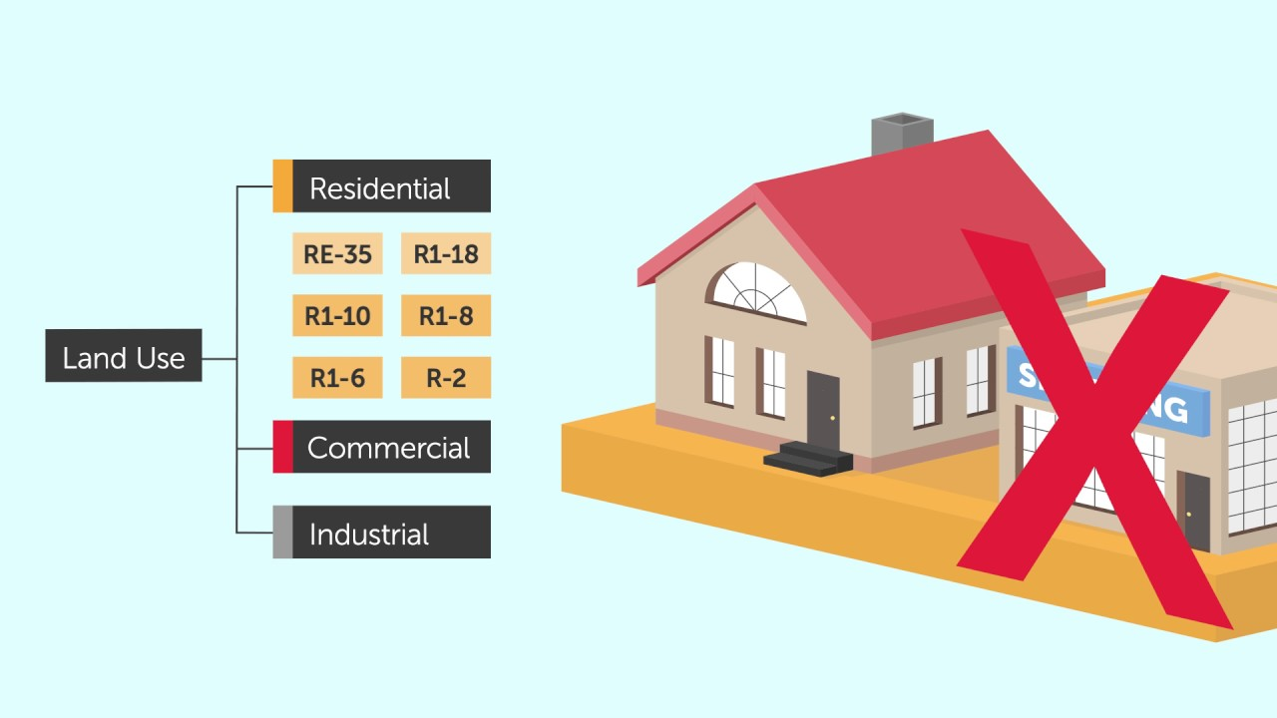
What Does the FHA have to do with Zoning?
Covers all housing transactions: rental, sales, appraisal, lending, zoning, home insurance, advertisement, development, land-use, etc.

Slide 15

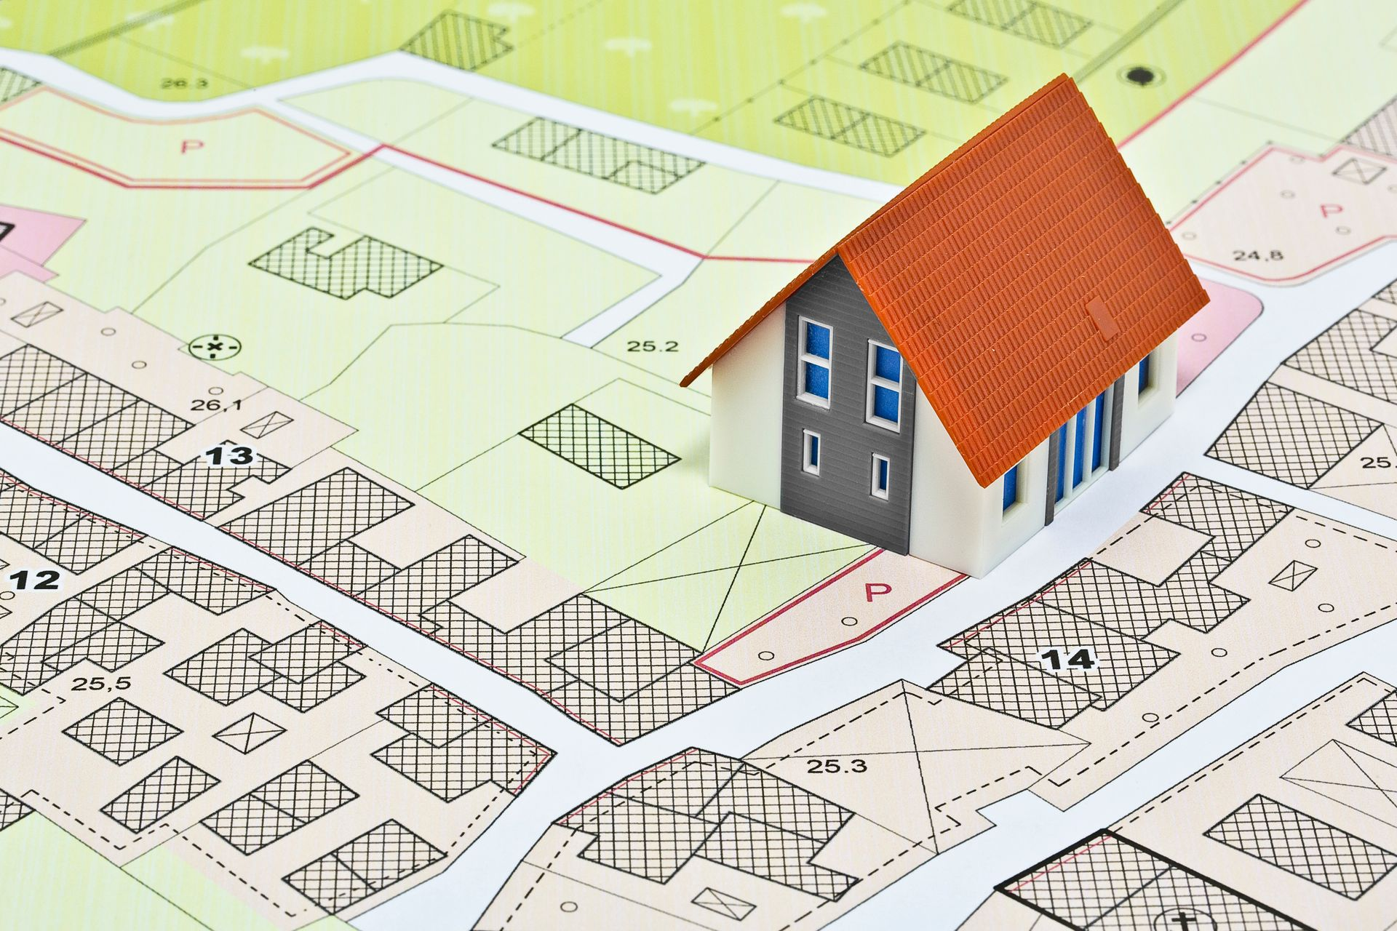

What Does the FHA has to do with Zoning?
The Act prohibits local government from making zoning or land use decisions or implementing land use policies that exclude or otherwise discriminate against protected persons, including individuals with disabilities.

Slide 16
Federal Fair Housing Law
The Fair Housing Act (FHA) prohibits local governments from using zoning, land use policies, or administrative actions to discriminate against residents based on race, color, national origin, religion, sex, familial status, or disability. Zoning decisions must not be based on prejudices, fear, or stereotypes regarding protected groups.
Key aspects of the intersection between the FHA and Zoning include:
Reasonable Accommodations: Municipalities must make reasonable exceptions to zoning regulations when necessary to provide equal housing opportunities, particularly for individuals with disabilities.

Slide 17
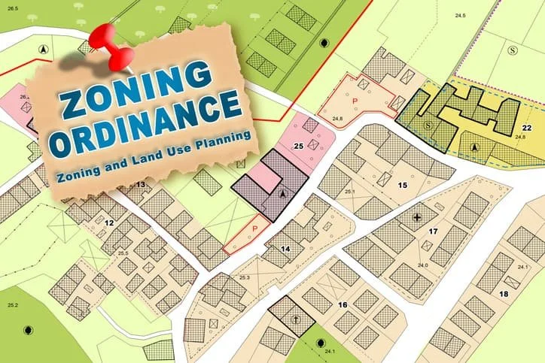
FHA mandates that zoning officials change, waive, or make exceptions in their zoning rules to afford people with disabilities the same opportunity to housing as those who are without disabilities.”
Reasonable Accommodation

Slide 18
Federal Fair Housing Law
The Fair Housing Act (FHA) prohibits local governments from using zoning, land use policies, or administrative actions to discriminate against residents based on race, color, national origin, religion, sex, familial status, or disability. Zoning decisions must not be based on prejudices, fear, or stereotypes regarding protected groups.
Key aspects of the intersection between the FHA and Zoning include:
Reasonable Accommodations: Municipalities must make reasonable exceptions to zoning regulations when necessary to provide equal housing opportunities, particularly for individuals with disabilities.
Group Homes: The FHA protects group homes for people with disabilities from being unfairly targeted or excluded by restrictive zoning ordinances.
Discriminatory Land Use: Zoning decisions that deny permits for multifamily or affordable housing based on the anticipated composition of the residents violate federal law.

Slide 19
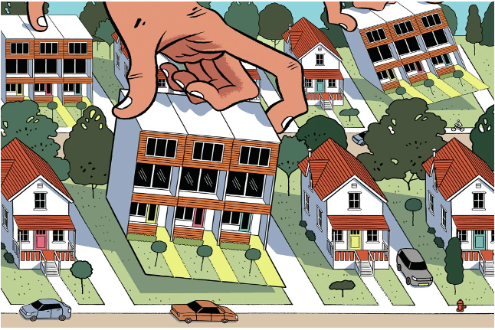
Discriminatory Zoning
Avoid exclusionary zoning - restrictions based on who will be living there. Is a protected class affected?
(Excludes certain types of land uses from a given community, especially to regulate racial and economic diversity).
Avoid restricting affordable housing because of the disability or race of residents, e.g. Sussex County, Del.
(Keeps affordable housing out of neighborhoods through land use and building code requirements).
Avoid restricting group home, shelters, or supportive housing because residents have mental disabilities.

Slide 20


Slide 21


Disability Defined
Federal law defines a person with a disability as:
  Any person who has a physical or mental impairment that substantially limits one or more major life activities;
  has a record of such impairment; or
  regarded as having such impairment.

Slide 22
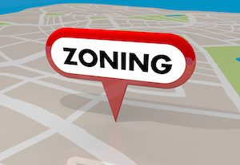
What is reasonable??
Reasonable Accommodation
Must be practical and feasible
Must be necessary/essential for use & enjoyment of dwelling
Must not cause an undue financial burden
Must not fundamentally alter the zoning scheme
Unless a municipality can prove that an accommodation request is unreasonable according to the above criteria, the municipality must grant the accommodation.

Slide 23
EXCEPTIONS
Direct threat. The FHA does not require a tenancy that would be a “direct threat” to the health or safety of other individuals, or result in substantial damage to the property of others, unless a reasonable accommodation could eliminate the threat.
Drug use. The current use of illegal drugs is excluded from the definition of disability.

Slide 24

Waive setback requirement so a resident can install a wheelchair accessible front walk
Grant exception for group home where an ordinance prohibits more than five unrelated people from living together
Allow installation of higher fence for individual with mental health disability to relieve anxiety from outside stimulation
of
Reasonable Accommodations

Slide 25



Can a state or local government limit the number of individuals who reside in a group home in a residential neighborhood?

Slide 26
Neutral laws that govern groups of unrelated persons who live together do not violate the Act so long as…
those laws do not intentionally discriminate against persons on the basis of disability (or other protected class)
those laws do not have an unjustified discriminatory effect on the basis of disability (or other protected class)
state and local governments make reasonable accommodations when such accommodations may be necessary for a person with a disability to have an equal opportunity to use and enjoy a dwelling

Slide 27

Illegal Zoning Practices

Slide 28


The Fair Housing Act makes it unlawful to…
Examples of Illegal Zoning Practices
Enforcing an ordinance that require groups of up to four unrelated disabled persons to reside only in certain zones, such as medical or commercial zones, when up to four unrelated non-disabled persons can live in any zoning district.

Slide 29

The Fair Housing Act makes it unlawful to…
Examples of Illegal Zoning Practices
Requiring neighbor notification or a public hearing only for the development of affordable housing or group homes, but not other types of residential development.
Taking action against, or deny a permit for a home because of the disability of individuals who live or would live there.
  Example: Denying a building permit for a home because it was intended to provide housing for persons with mental illness.
Denied

Slide 30


The Fair Housing Act makes it unlawful to…
Examples of Illegal Zoning Practices
Imposing restrictions or additional conditions on group housing for persons with disabilities that are not imposed on families or other groups of unrelated individuals.
Example: Requiring an occupancy permit for persons with disabilities to live in a single-family home while not requiring a permit for other residents of single-family homes.
Imposing restrictions on housing because of alleged public safety concerns that are based on stereotypes about the residents’ or anticipated residents’ membership in a protected class.
  Example: Requiring a proposed development to provide additional security measures based on a belief that persons of a particular protected class are more likely to engage in criminal activity.
Group Homes

Slide 31
The Fair Housing Act makes it unlawful to…
Examples of Illegal Zoning Practices
1000
Feet
2500
Feet
1500
Feet
Enforcing an ordinance that requires group homes of up to four unrelated disabled persons to maintain a certain distance from other such homes – 1,000 feet, 1,500 feet, 2,500 feet – while groups of up to four unrelated non – disabled persons do not have any similar limitation.

Slide 32

The Fair Housing Act makes it unlawful to…
Examples of Illegal Zoning Practices
Utilizing land use regulations or actions that treat groups of persons with disabilities less favorably than groups of non-disabled persons.
Refusing to make reasonable accommodations, for persons with disabilities, in land use and zoning regulations, policies and procedures.
Enacting or implementing land-use rules, ordinances, policies or procedures that restricts or deny housing opportunities or make unavailable or deny dwellings to persons because they are a member of the protected class.

Slide 33
Will state and local governments violate the Fair Housing Act if they adopt or
implement restrictions on where families with children may reside?

Slide 34

State and local governments may not impose restrictions on where families with children may reside unless the restrictions are consistent with the “housing for older persons” exemption of the Act.
The most common types of housing for older persons that may qualify for this exemption are:
housing intended for, and solely occupied by, persons 62 years of age or older;
housing in which 80% of the occupied units have at least one person who is 55 years of age or older that publishes and adheres to policies and procedures demonstrating the intent to house older persons. These types of housing must meet all requirements of the exemption, including complying with HUD regulations applicable to such housing, such as verification procedures regarding the age of the occupants.

Slide 35
(NIMBY)

Slide 36

NIMBY. . . Many communities continue to enact affordable housing restrictions, use exclusionary zoning practices, impose excessive subdivision controls, and establish delaying tactics for project approvals. These development barriers can effectively exclude rental and affordable housing development in a community.

Slide 37

28
Discrimination in Zoning Can Be Costly

Slide 38
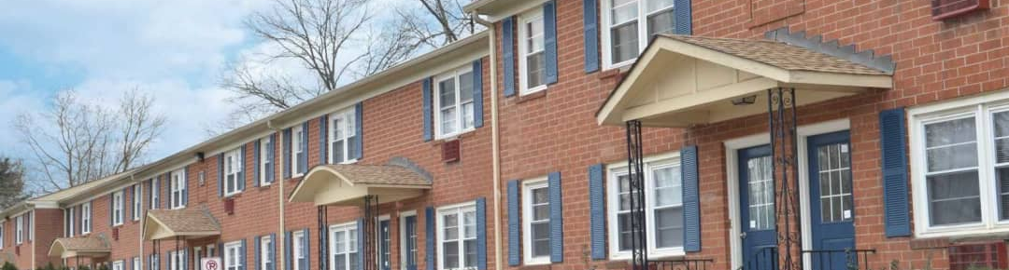
Affordable Housing
Path Stone Housing Corp. V. Whitehall Township, PA
Whitehall Township agreed to pay $375,000 to settle allegations that Whitehall discriminated based on race, national origin, family status, and disability when it denied a proposal to construct 49 units of affordable multifamily housing in the Township.
Residents opposed the project complaining that an apartment building would crowd and change the makeup of the neighborhood.
Whitehall Zoning Hearing Board denied the project on the basis that there was inadequate parking.

Slide 39
Does a state or local government violate the Fair Housing Act if it considers the fears or prejudices of community members when enacting or applying its zoning or land use laws respecting housing?

Slide 40

State and local governments may not act because of the fears, prejudices, stereotypes, or unsubstantiated assumptions that neighbors may have about prospective residents.
Example: A city may not deny zoning approval for a low-income housing development that meets all zoning and land use requirements because the development may house residents of a particular protected class whose presence, the community fears, will increase crime and lower property values.

Slide 41



Group Home
Cromwell Connecticut October 2021
Relman Colfax Law Firm obtained a precedent-setting $5.2 million jury verdict in a case involving the Town of Cromwell’s discrimination against a group home for men with mental health disabilities. Gilead Community Services, a non-profit serving people with mental health disabilities in Connecticut since 1968, sought to open a six-person home in Cromwell, Connecticut. Responding to the discriminatory opposition of neighbors, Cromwell and three of its high-ranking officials waged a campaign that resulted in the closure of the home in August 2015.

Slide 42
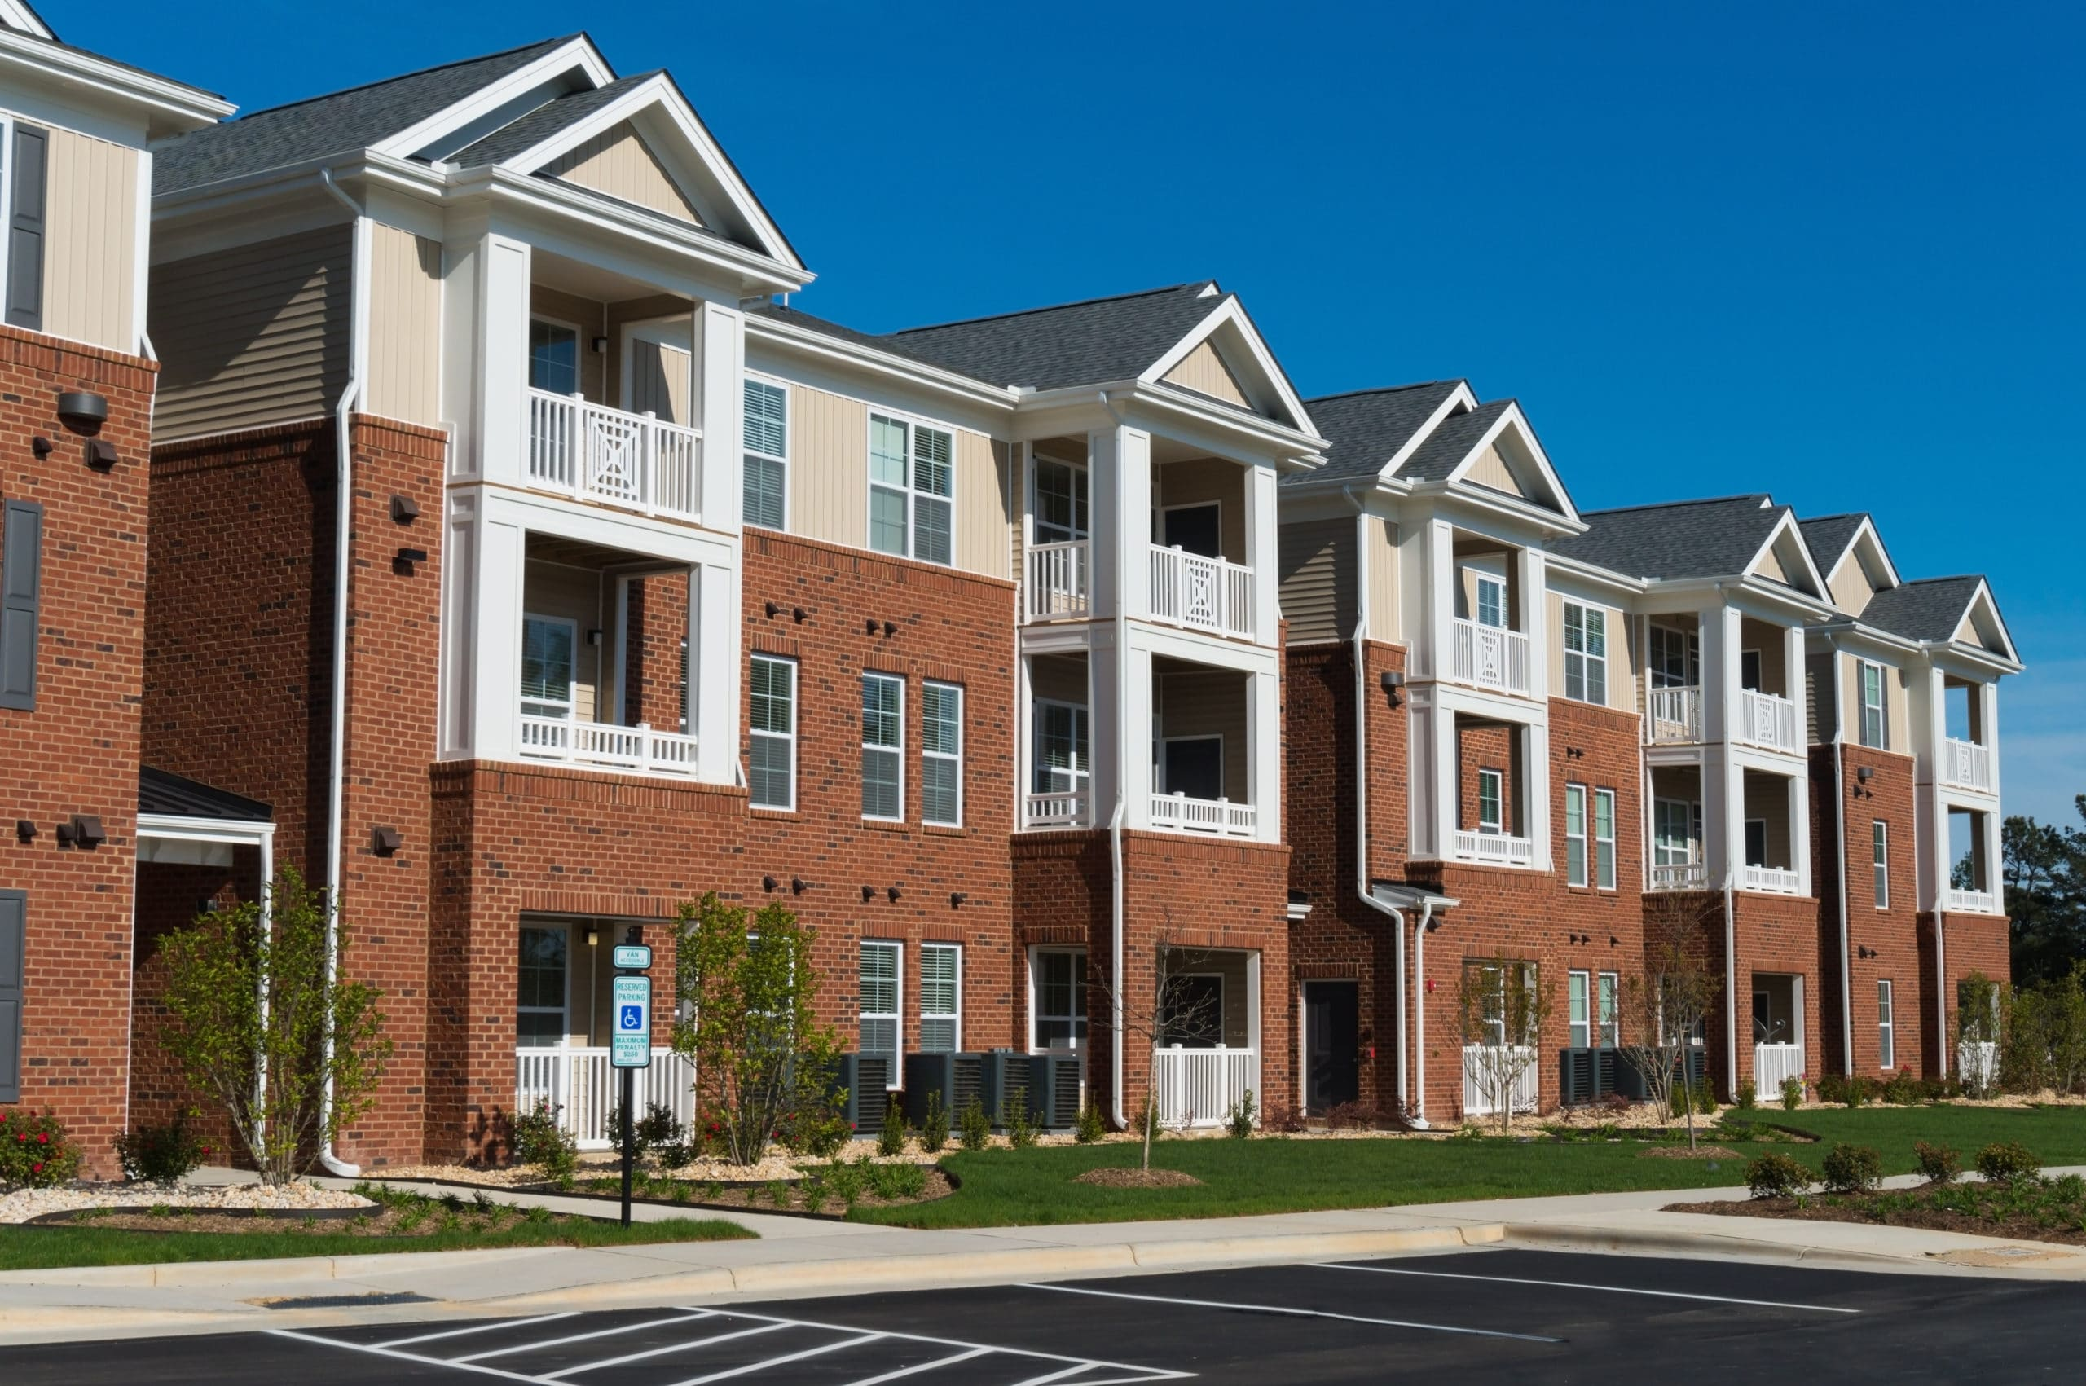
Affordable
Housing
Chicago, Illinois April 19, 2016
Relman Colfax Law Firm filed this FHA lawsuit in federal district court in Chicago on behalf of the Buckeye Community Hope Foundation, a non-profit affordable housing developer, against the Village of Tinley Park. The parties negotiated a $2.45 million settlement in a case involving the Village's actions discriminating against African Americans and families with children and perpetuating segregation in the community. Buckeye began plans to develop a 47-unit affordable housing complex in the Village of Tinley Park, Illinois that would serve the area's low-income households. Responding to the discriminatory attitudes toward African Americans by residents, officials acceded to the discrimination by expressing support for the opponents. The officials took a series of unprecedented and impermissible actions to delay and derail the project.

Slide 43
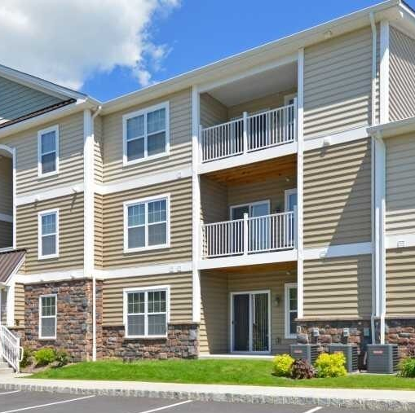
Prohibiting multifamily housing
Affordable Housing
The Planning and Zoning Commission of Sussex County, Delaware agreed to pay $750,000 to settle a lawsuit. Based on the assumption that subdivision’s residents would be Latino and African-American, the county’s planning and zoning commission denied land use approval for a 50-lot affordable housing subdivision.
Discrimination Can Be Expensive

Slide 44


Florida
Sarasota County, Florida agreed to pay $760,000 to settle two lawsuits alleging the county discriminated against persons with disabilities when it refused to allow group homes for persons in recovery from alcohol and substance abuse to operate.
Discrimination based on disability is prohibited under the law. Recovering drug addictions is covered under the Fair Housing Act.

Slide 45

Discrimination is Costly
EXPRESS NEWS
Dalton Township, Michigan agreed to pay $62,500 to settle a lawsuit alleging that the township discriminated against a group home for persons recovering from drug and alcohol addiction.
February 2011

Slide 46

New Orleans
City of New Orleans, Louisiana October 2023
Relman Colfax Law Firm filed a lawsuit in federal court against the City of New Orleans, Louisiana on behalf of Stanton Square, LLC, a housing developer. The lawsuit alleges that the Defendants delayed, prevented, and otherwise interfered with Plaintiff’s attempts to construct a multi-family affordable housing apartment complex in the City of New Orleans. The apartment complex would help alleviate the need for affordable housing, particularly among African Americans, Hispanics, and families with children. Despite the property at issue being zoned for this purpose, the City Council placed an immediate moratorium on the issuance of permits for multi-family housing. The complaint challenges the moratorium. The complaint also alleges that the City Council’s action was influenced by a discriminatory campaign from the English Turn Property Owners’ Association and other groups, and that the campaign included coded discriminatory language and negative stereotypes about minorities and lower-income families with children.
Affordable Housing

Slide 47
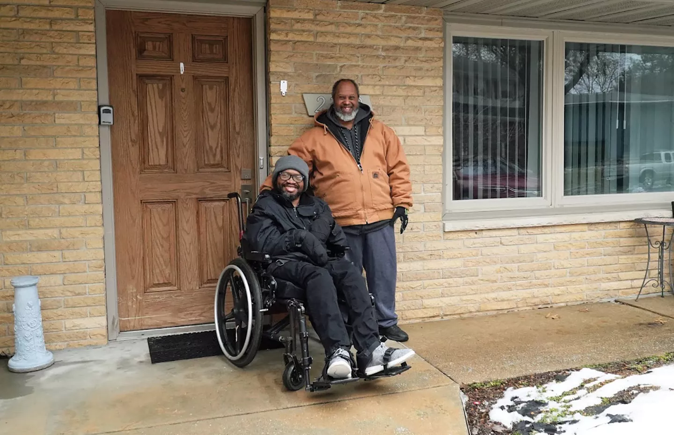
City of Springfield, Illinois Violated the FHA by Enforcing Discriminatory Spacing Ordinance
December 8, 2023
A federal court in Illinois entered a permanent injunction against the City of Springfield, Illinois, prohibiting it from enforcing a local spacing ordinance that bans people with disabilities from living in homes within 600 feet of one another if the home has five or fewer residents. Even though the home was operating in compliance with state requirements, the city attempted to shut it down in 2016 by relying on a local spacing ordinance. The Justice Department filed suit against the City of Springfield in 2017.
Assistant Attorney General in the Justice Department’s Civil Rights Division said “Restrictive zoning laws and policies that prevent people with disabilities from integrating into society at large have no place in our marketplace today. The court’s decision makes clear that there are real consequences to cities and other municipalities when they unlawfully and immorally exclude people with disabilities from residential neighborhoods.”
$408,637
$162,000 in compensatory damages to the residents
$131,000 in compensatory damages to Individual Advocacy Group (the state-licensed agency that provides services to the home’s residents)
$61,982.50 in civil penalties
$53,654.50 awarded in prejudgment interest to IAG
City ordered to undergo fair housing training

Slide 48
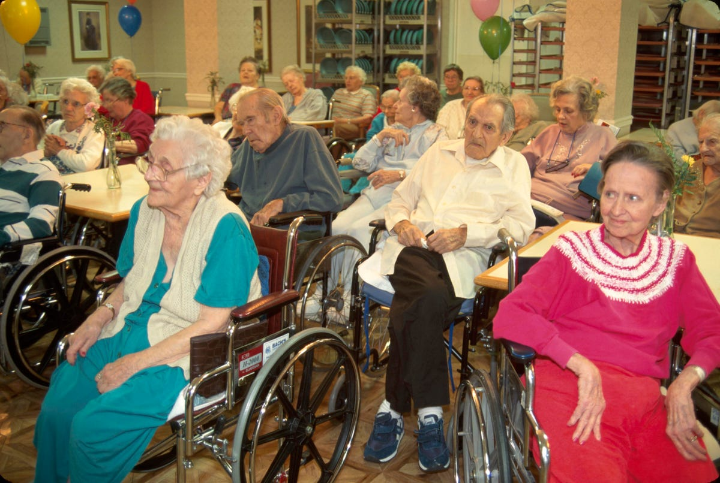

Discrimination is Costly
A case in Toledo resulted in the city paying $95,500 to settle allegations that they violated the Fair Housing Act by refusing to grant operating permits to two organizations that operate group homes providing assisted living arrangements for elderly disabled residents.
Group

Slide 49


DISCRIMINATION is costly
MILLION DOLLAR ZONING POLICY
A federal jury awarded $1 million to an Albany, New York builder who sought to build a development with 50-60 affordable units. Evidence showed the city blocked the builder’s proposed development and rezoned the site where such a development would be prohibited.
$$$$$$$$$$$

Slide 50

Actual damages
Punitive damages
Civil penalties
$
  $26,262 for a first violation.
  $65,653 for violations within previous 5 years and are again in violation.
  $127,983 two or more violations within previous 7 years.
Government monitoring
Attorneys’ fees
Loss of tax credits
for
Violating the FHA
Enforcement: The Department of Justice and HUD investigate complaints, and discriminatory zoning codes are considered invalid under the Supremacy Clause.

Slide 51


CONCLUSION
CONCLUSION
impose restrictions on group homes because residents have mental disabilities
require additional studies or procedures when considering a development that may be occupied by members of the protected classes
deny land use approval for affordable housing because of the disability or race of residents
require notification or a public hearing only for the development of homes which might target protected classes
impose restrictions or reject a proposed housing development because of alleged public safety concerns, neighbors’ fears or stereotypes

Slide 52
CONCLUSION
require group homes of up to four unrelated disabled persons to maintain a certain distance from other such homes
refuse to allow an exception or variance to a setback requirement as a reasonable accommodation for a disabled resident
delay or temporary suspend an activity
have burdensome or an expensive process for resident to apply for a conditional use

Slide 53
CONCLUSION
refuse to make reasonable accommodations for persons with disabilities, in land use and zoning regulations, policies and procedures
deny a building, renovation, special use permit or re-zoning based on objections to residents of the development or home
require persons with disabilities to request permits to live in single-family zones while not requiring persons without disabilities to request such permits.

Slide 54




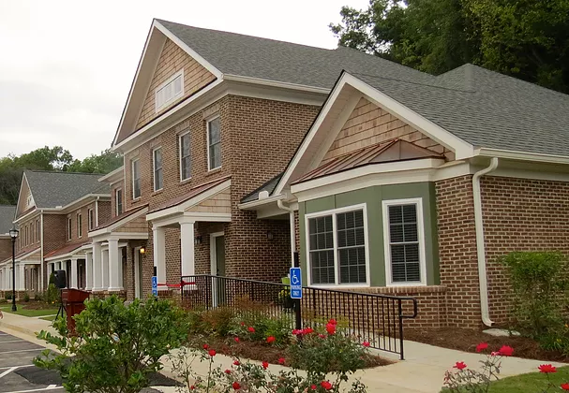
Discrimination Says…
NIMBY

Slide 55





The Fair Housing Law Says…
Live Anywhere You Can Afford
Jet’s Group Home

Slide 56





Slide 57



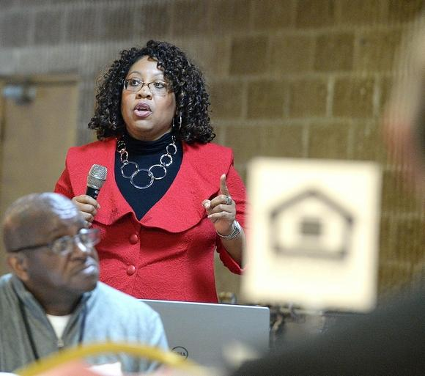
Valerie Watson
Fair Housing Manager
Canton, Ohio 44702
Stark County Fair Housing Dept. 330-451-7775
vjwatson@starkcountyohio.gov

Slide 58


OTHER RESOURCE
JOINT STATEMENT OF THE DEPARTMENT OF HOUSING AND URBAN
DEVELOPMENT AND THE DEPARTMENT OF JUSTICE
STATE AND LOCAL LAND USE LAWS AND PRACTICES AND THE APPLICATION OF THE FAIR HOUSING ACT
https://www.justice.gov/opa/file/912366/download

Slide 59

OTHER FAIR HOUSING RESOURCES
HUD/DOJ Joint Statement “Group Homes, Local Land Use & the Fair Housing Act”
https://www.justice.gov/crt/joint-statement-department-justice-and-department-housing-and-urban-development
Reasonable Accommodations Under the Fair Housing Act
https://www.hud.gov/sites/documents/huddojstatement.pdf
Reasonable Modifications Under the Fair Housing Act
https://www.hud.gov/sites/documents/reasonable_modifications_mar08.pdf
Accessibility (Design & Construction) Requirements for Covered Multifamily Dwellings Under the Fair Housing Act
https://www.hud.gov/sites/documents/JOINTSTATEMENT.PDF

Slide 60
Even a law that is seemingly neutral will still violate the Act if enacted with discriminatory intent. In that instance, the analysis of whether there is intentional discrimination will be based on a variety of factors, all of which need not be satisfied. These factors include, but are not limited to: (1) the “impact” of the municipal practice, such as whether an ordinance disproportionately impacts minority residents compared to white residents or whether the practice perpetuates segregation in a neighborhood or particular geographic area; (2) the “historical background” of the action, such as whether there is a history of segregation or discriminatory conduct by the municipality; (3) the “specific sequence of events,” such as whether the city adopted an ordinance or took action only after significant, racially-motivated community opposition to a housing development or changed course after learning that a development would include non-white residents; (4) departures from the “normal procedural sequence,” such as whether a municipality deviated from normal application or zoning requirements;
Examples of land use practices that violate the Fair Housing Act under a discriminatory effects standard include minimum floor space or lot size requirements that increase the size and cost of housing if such an increase has the effect of excluding persons from a locality or neighborhood because of their membership in a protected class, without a legally sufficient justification. Similarly, prohibiting low-income or multifamily housing may have a discriminatory effect on persons because of their membership in a protected class and, if so, would violate the Act absent a legally sufficient justification.

Slide 61
Does the Fair Housing Act protect persons with disabilities who pose a “direct threat” to others?
The Act does not protect an individual whose tenancy would constitute a “direct threat” to the health or safety of other individuals or whose tenancy would result in substantial physical damage to the property of others unless the threat or risk to property can be eliminated or significantly reduced by reasonable accommodation. A determination that an individual poses a direct threat must rely on an individualized assessment that is based on reliable objective evidence (for example, current conduct or a recent history of overt acts). The assessment must consider: (1) the nature, duration, and severity of the risk of injury; (2) the probability that injury will actually occur; and (3) whether there are any reasonable accommodations that will eliminate or significantly reduce the direct threat.

Slide 62
Can a state or local government impose health and safety regulations on group home operators?
Yes, but such
regulations must not be based on stereotypes about persons with disabilities or specific types of
disabilities. State or local zoning and land use ordinances may not require individuals with disabilities to receive medical, support, or other services or
supervision that they do not need or want as a condition for allowing a group home to operate.
State and local governments’ enforcement of neutral requirements regarding safety, licensing,
and other regulatory requirements governing group homes do not violate the Fair Housing Act so
long as the ordinances are enforced in a neutral manner, they do not specifically target group
homes, and they do not have a

